Slide 1
Mwb Retrieval
Define risk.
Give an example of an activity that carries risk

Slide 2
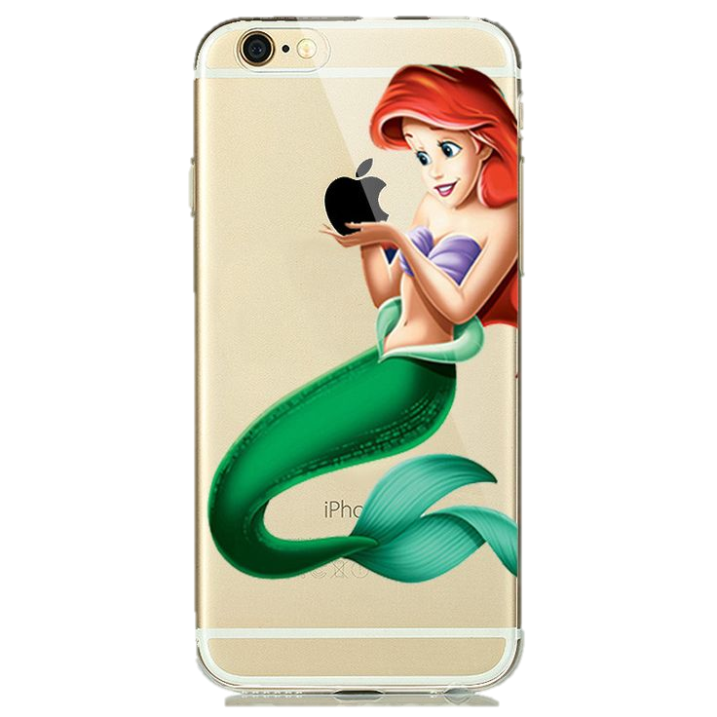
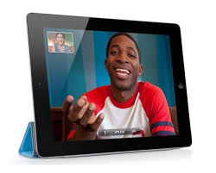
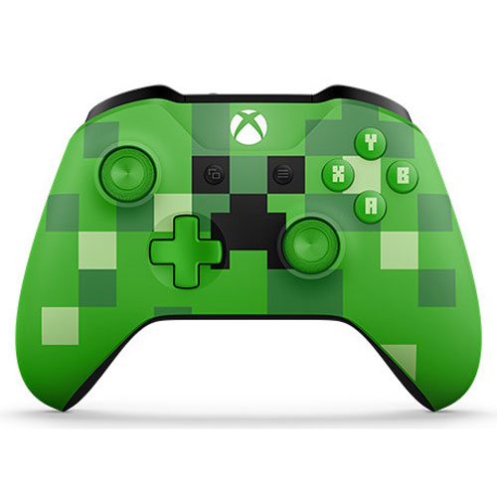
Online safety
Notes:
As each picture comes up, ask pupils to identify it and discuss who in class uses it and how.

Slide 3
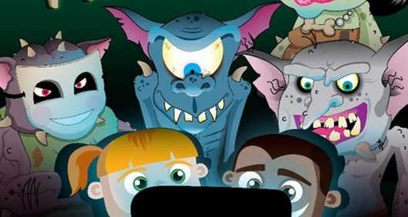
1-How can some of these sites and apps cause safety issues for some young people?
2-How can some of these sites effect peoples self esteem and self confidence?
Notes:
Allow pupils time to think, pair and share when answering the question.

Slide 4
Safety: How old do you have to be to use?…..
13+
16+
13+
13+
13+
Notes:
Allow time for guessing

Slide 5
Online safety: Sharing information
https://www.youtube.com/watch?v=1FFl6S3ka_A
Notes:
Discussion suggestions: What could the consequences have been for the girl? What could she do differently to avoid this?

Slide 6
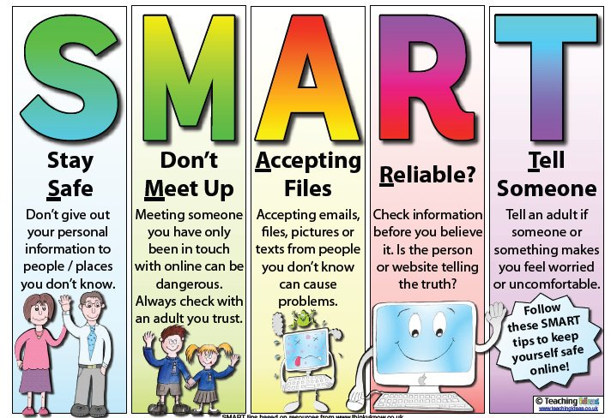
ONLINE SAFETY: TRUST
https://www.youtube.com/watch?v=GAXBz5kC3CQ

Slide 7
Task
The links below are from the www.net-aware.org.uk website. This site provides information and guidelines for young people on how to stay safe online.
COPIES OF THE NOTES IN THE FILES TO PRINT
https://www.net-aware.org.uk/networks/snapchat/
https://www.net-aware.org.uk/networks/whatsapp/
https://www.net-aware.org.uk/networks/instagram/
https://www.net-aware.org.uk/networks/facebook--messenger/
https://www.net-aware.org.uk/networks/tiktok/
Notes:
These pages will need to be printed before the lesson for use in small groups of 4 or 5.

Slide 8
Read the information about the app or website.
Come up with:
1 positive thing about using the site
2 risks of using the site for young people.
3 ways in which it could be made safer for young people
Be prepared to feedback the information to the rest of the class

Slide 9
So, how can social media effect our self-esteem?
When you look through your social media, have you ever thought about how many posts are honest?
What percentage of what you see is positive or happy?
Think about your own day to day mood…
Are you always upbeat? Or do you have days when you feel differently?
Discuss with your class:
Why do social media posts always seem so happy or positive?

Slide 10
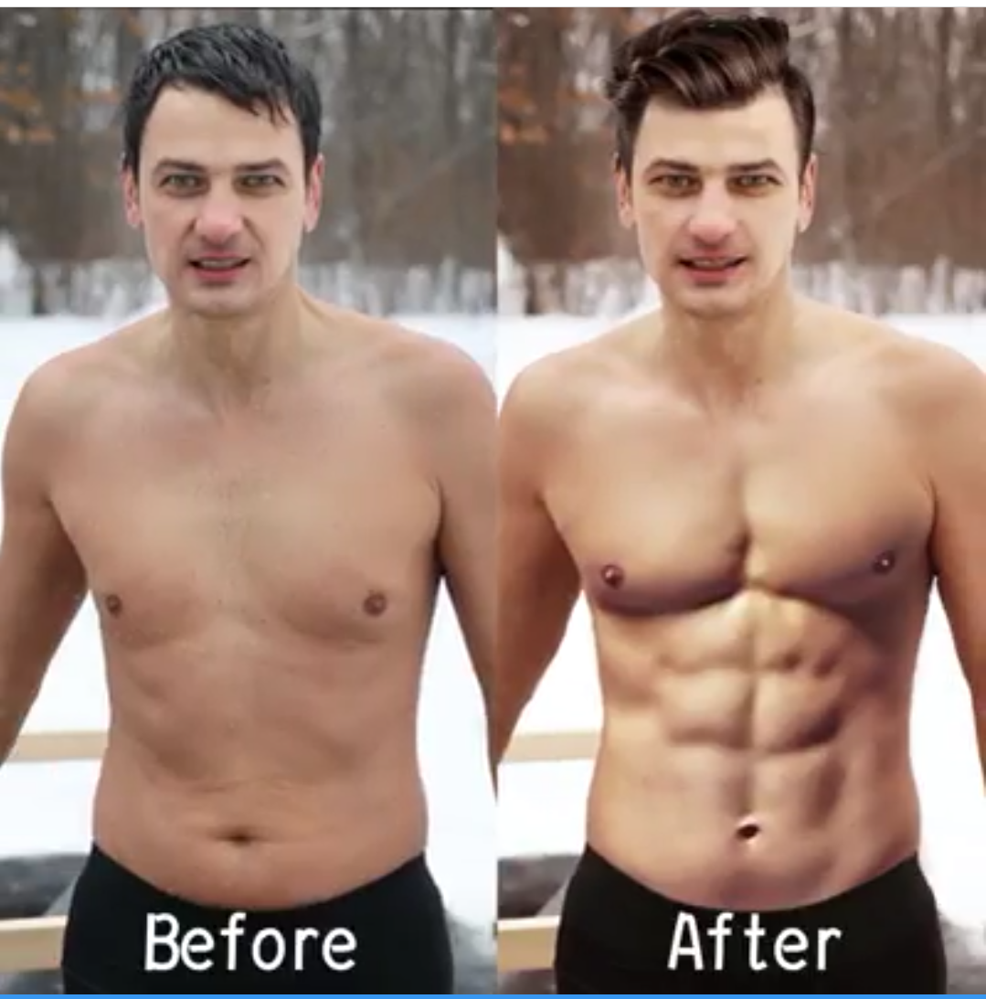
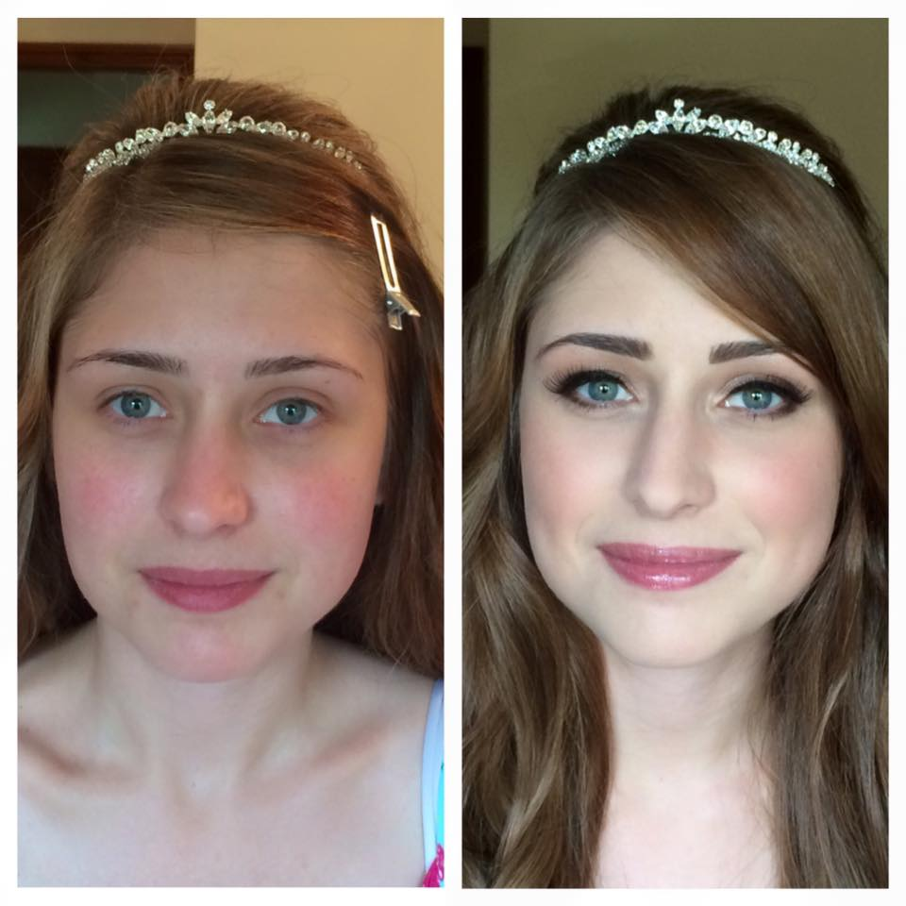
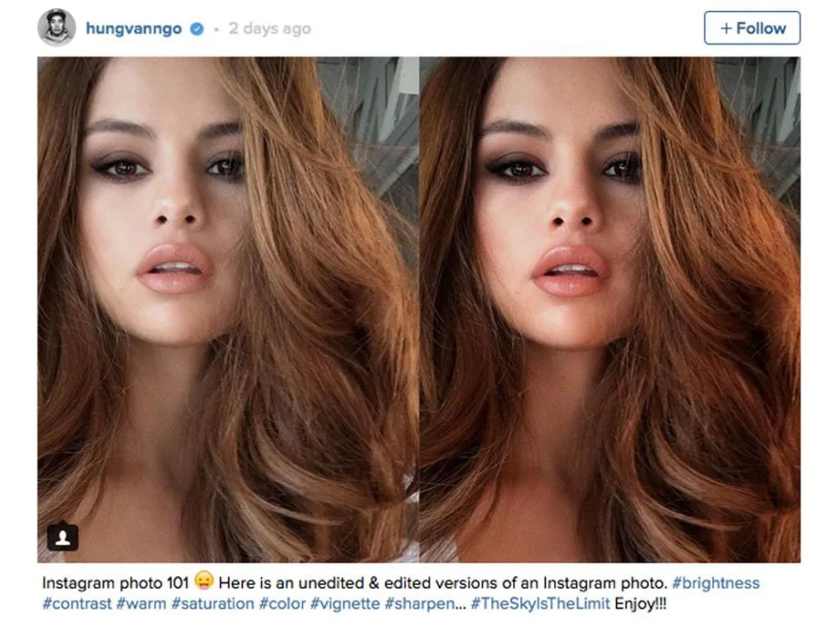
Is it real? Think about it: Have you ever felt jealous or inferior when you see a photograph on social media?
Why might these people not want to show off their true selves?
Think and feedback…
What are we seeing here?
Low self esteem
Inferiority
Lacking in confidence
What else?
Filters
Make up
Airbrushing
Anything else?

Slide 11
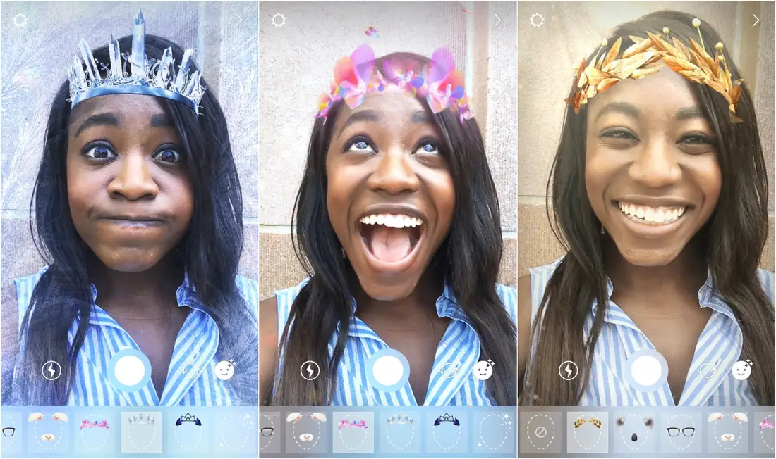
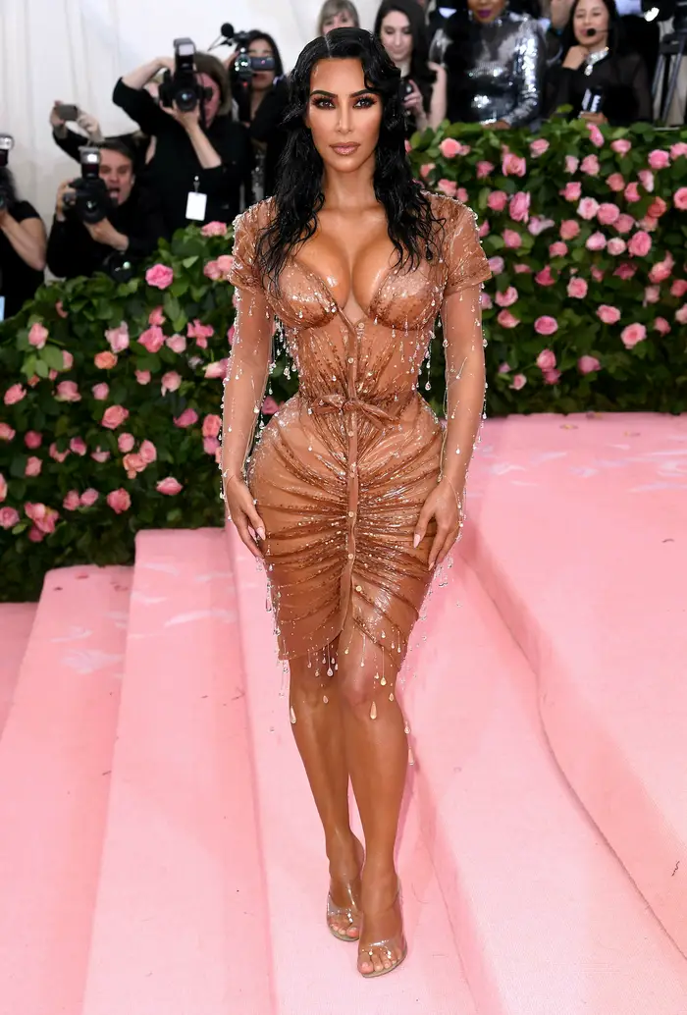
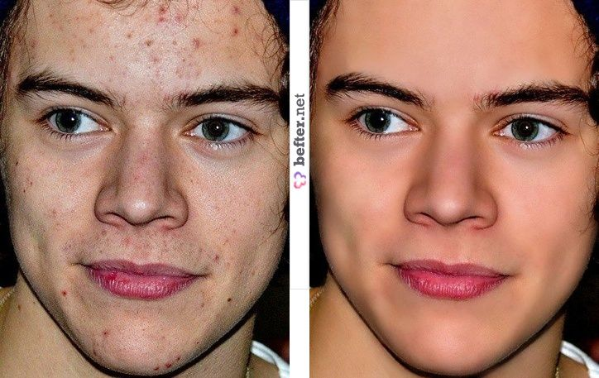
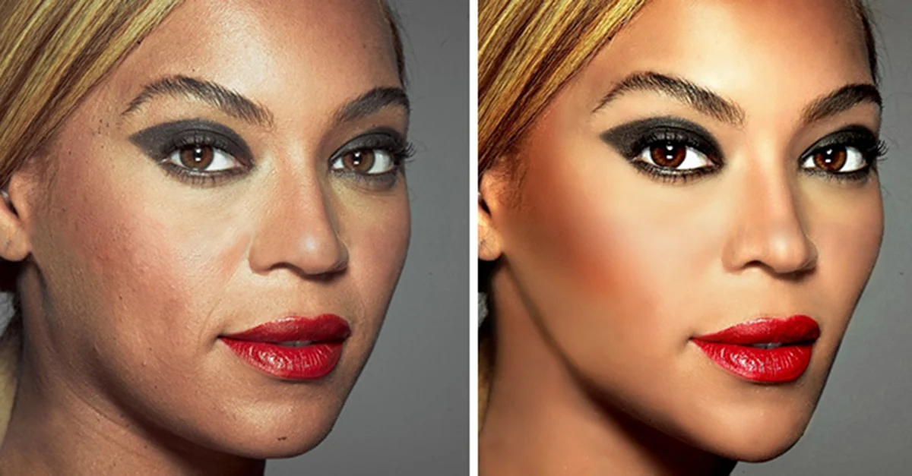
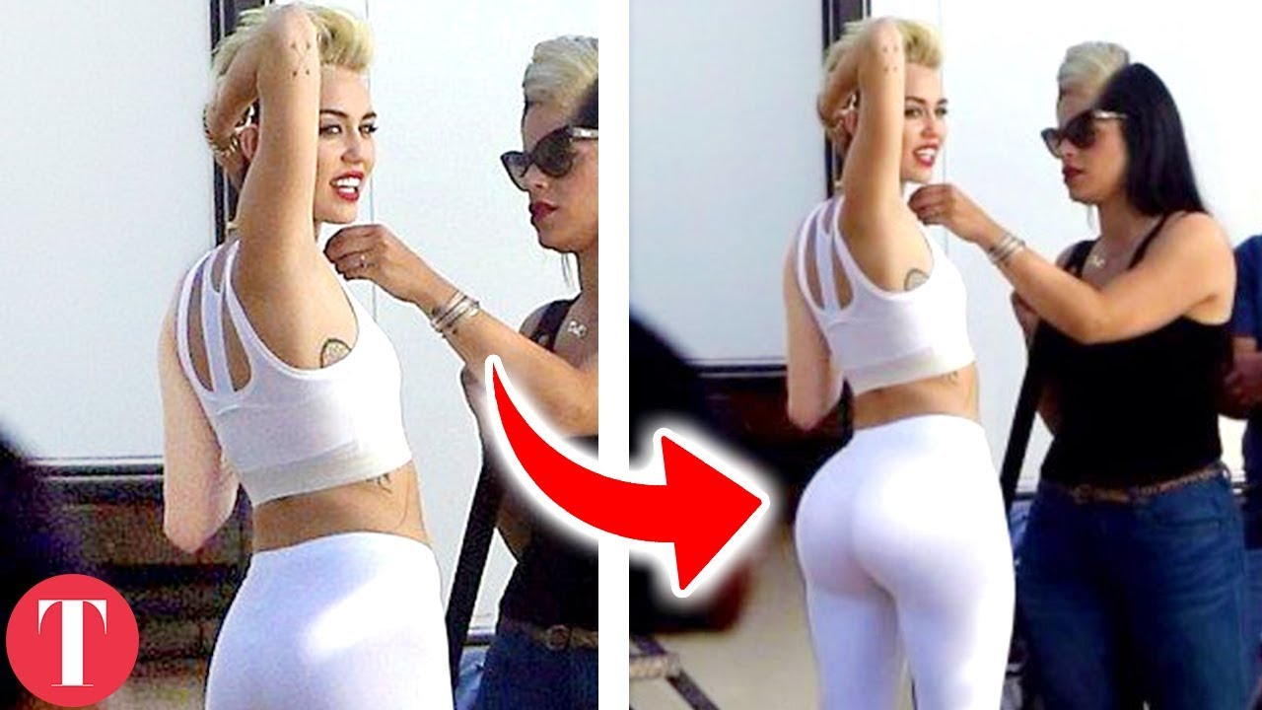
So, a 12 year old girl sees a photo of Kim Kardashian, for example……
She wishes she was that tanned, thin etc
It could effect her mood, making her feel stressed or upset that she isn’t good enough.
Many months after this photo was taken Kardashian shared another image…
How many of the photos we see are real?
Even the celebrities are at it?

Slide 12
Why is this a bad thing?
Does Kardashian have a responsibility to her fans to stop promoting such unhealthy and unrealistic body images?
OR
Should she be able to dress and share photos of her choice?
Kardashian revealed that she had worn a special type of corset which:
-Took 3 men to fasten
-She had to prepare to wear with special breathing training
-She could not sit down in all night
-Left marks and indentations on her body after she took it off
-Was so uncomfortable, she said “I have never felt pain like that in my life”
So, a 12 year old girl sees a photo of Kim Kardashian, for example……
She wishes she was that tanned, thin etc
It could effect her mood, making her feel stressed or upset that she isn’t good enough.
She could start an unhealthy diet regime to replicate what she sees. Or she could start to hide her own body away.
Many months after this photo was taken Kardashian shared another image…

Slide 13
Where can I get help?
https://www.thinkuknow.co.uk/11_13/help/

Slide 14
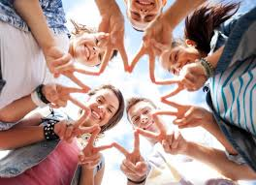
Whole class task
Using all the information from the lesson, create a class list of Dos and Don’ts, focusing on online safety.
Notes:
This can be created on the board with pupils writing their ideas up.

