Slide 1
Disability: A physical or mental condition that limits a person's movements, senses, or activities.
Different

Slide 2
Key Words
Inclusion
The action or state of including or of being included within a group or structure.
Equality
The state of being equal, especially in status, rights, or opportunities.
Autism
A lifelong, developmental disability that affects how a person communicates with and relates to other people, and how they experience the world around them.
Acceptance
General agreement that someone should be included in a group.
Bullying
Seeking to harm, intimidate, or coerce someone perceived as vulnerable.

Slide 3
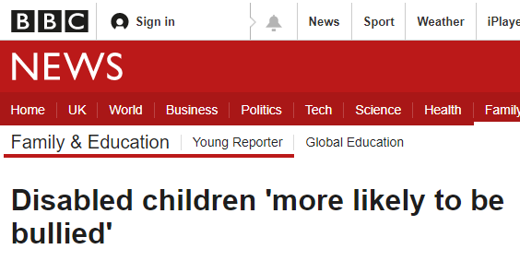
Bullying
Please watch this video:
Boy commits suicide after being bullied
How does this make you feel?
What do you think could have happened to change the outcome?
The story resonated with many people. They felt they had to do something to ensure this never happened to any child, ever again. A campaign started on Twitter called #BagsOutForSeven, where people with bags known as Colostomy bags, Ostomy bags or Stomas, shared pictures of themselves in support of Seven. They hoped by doing this, they could normalise the issue and stop any bullying.

Slide 4
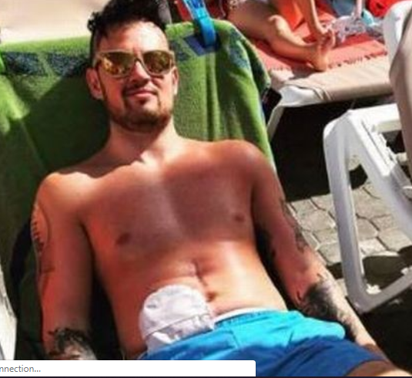
One man even made a video, describing how his bag had not only saved his life, it had improved it. Read the following article and watch the accompanying video: Man makes inspiring video
How might this campaign have made Seven feel if he had seen it whilst he was alive?
What else do you think could be done?

Slide 5
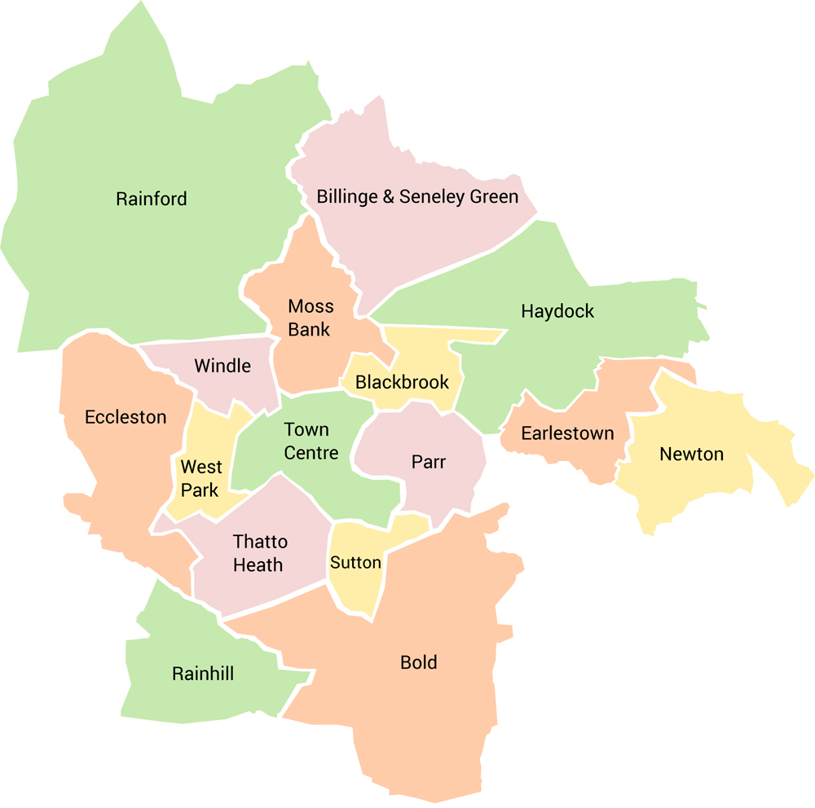
And what about in St Helens?
One of our very own pupils, Charlotte took the brave step of joining the campaign for Seven.
Charlotte
Read the article and discuss:
How you may have felt about sharing a picture like this, would it have been difficult? If so, why?
How might other teenagers living with a stoma feel when they see this article?

Slide 6
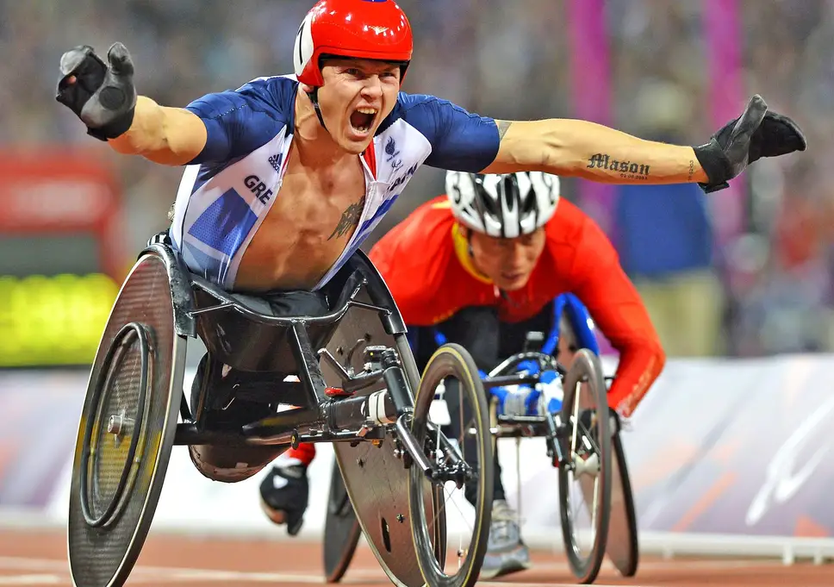
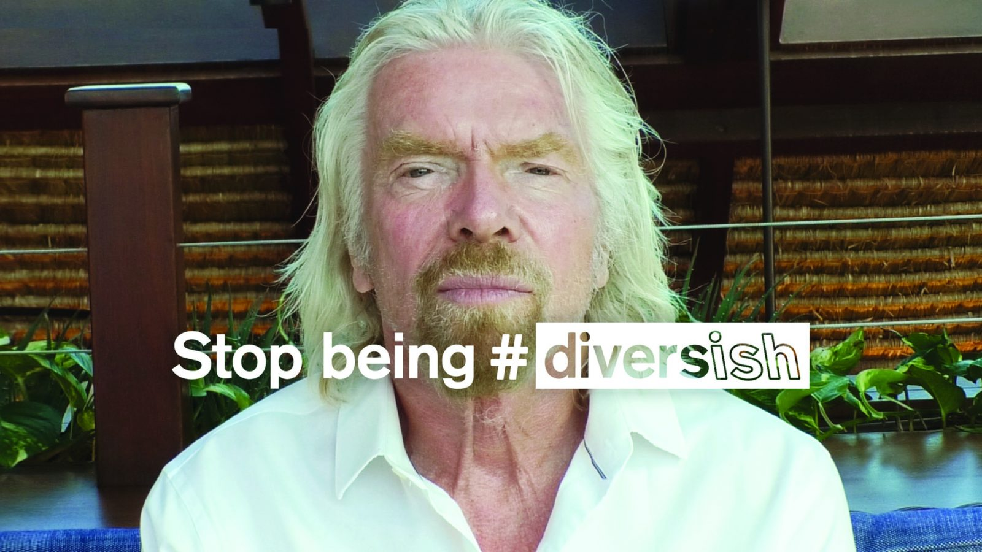
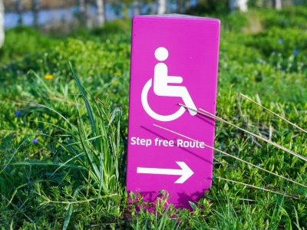
Inclusivity
There has been a lot of work done in the UK, with the aim of improving inclusivity and equality for people living with a disability. For example…

Slide 7
Inclusivity: What else can we do?
Working in groups, read the case study given to you by your teacher. You will need to think about…
What is already being done to support this persons needs?
What could be done by people on an individual level?
How could The Sutton Academy improve inclusivity for this person?
What could the UK do?
Swap your work with another group, who will read it and offer you 2 strengths and 2 ways to improve in green pen. You will then have 5 minutes to work on their suggestions.
You will then feedback your findings to the rest of the class.

Slide 8
Katie | Sean | Oliver
Amelia | Ruby | Callum

