Slide 1
Relationship Expectations…
LO: To learn about what a healthy relationship entails.

Slide 2

Topic 1: Effects of the Media

Slide 3


Take a post it note…
Imagine it is 2029 and you are in a long term relationship.
What would you want the relationship between you and your partner to be like?
Write one word on the post it which reflects your thoughts… (remember-you are in school!)
Notes:
Notes should be stuck up at the front of the room, teacher will need to scan them and remove any inappropriate content

Slide 4








Look at these examples of programs from the media...
Notes:
Gauge how many have seen these programs/know what they are/anyone who does not?

Slide 5
Debate sheets…
We are going to do some work on the examples of media from the last slide. You are working in groups of about four.
You must respond to every statement, writing your feedback directly onto the sheet. You can respond either to the main quote or what a classmate has written.
10 minute timer
Notes:
It may be worth printing out the statement sheets on A3 paper to allow more space for comments.

Slide 6
Feedback on statement sheets…
This can either be done by a member of the class or by the teacher themselves.
Feedback some statements from each of the debate sheets.
Notes:
Choose sensible pupils you can trust to take out any appropriate pupils

Slide 7
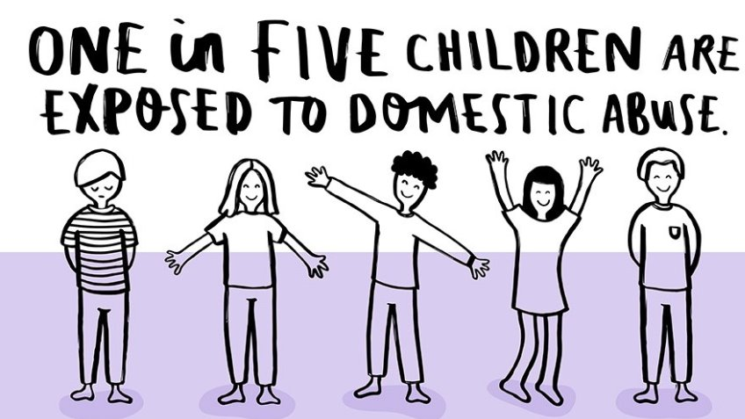
Topic 2: Abuse in relationships

Slide 8
Relationship Abuse…
Discuss: What types of abuse can you experience in a relationship?
Next-watch this clip:
https://www.youtube.com/watch?v=ObvC12uJa6A&feature=youtu.be
Notes:
Physical/emotional/mental/coercion/sexual etc

Slide 9
Follow the link to the article… https://www.bbc.co.uk/news/uk-wales-50390689
Discuss as a class:
Were you surprised by the findings?
Have you seen a friend in a relationship were there is abuse?
What advice did/would you give the victim?
Do you think you would tell a friends parents that you were worried about abuse, even though you know your friend would be angry?

Slide 10

It is okay to disagree…
      A ‘normal’ healthy disagreement can happen between people who feel able to express their views and opinions, but also respect those of others. A healthy disagreement normally involves negotiation, and no one emerges as the ‘winner’ or the ‘loser’.

Slide 11
True or false…
In small groups, read the statements on the sheet. Add a ‘T’ to those you think are true and a ‘F’ to those you think are false. You have 5 minutes…
10 minute timer

Slide 12

Feedback and Discussion…

Slide 13

Topic 3: Consent in Relationships

Slide 14
Topic 3: What is consent?
      Consent is defined in law as an agreement made by someone with the freedom and ability to decide something. Under the law, it is the person seeking consent who is responsible for ensuring that these conditions are met
      To give your consent you should be sure that it is your decision and not one you have been pressured to make
      British law says that both people need to give their consent before sex or any physical closeness
      The law also says that to consent to sex a person must be 16 or over and have the ability to make informed decisions for themselves (i.e. they have to be mature enough to make the decision and not be impaired by e.g. drugs or alcohol )

Slide 15

More information…
Consent

Slide 16
Myths and misconceptions…
Decide whether the ‘Myths and misconception?’ cards are True; False; Not sure
5 minute timer

Slide 17
Answers…
Use the following slides to decide whether you have the misconceptions in the right category.

Slide 18
A rapist is usually a stranger in a dark alley.
The majority of rapes are committed by people known to, and often trusted by, the person who is raped . They could be friends, partners, family members or known from school, college or work.
If two people have had sex before, it is always ok to have sex again.
Even if two people have had sex before, they should both be consenting each time they subsequently have sex.
People who are raped ‘ask for it’ by wearing revealing or provocative clothing.
The clothes a person wears never mean they are ‘asking for it’. Rape of sexual assault are never the victim’s fault. It is always the fault of the attacker. People who are assaulted and attackers can be any age, sex, religion, gender identity and sexual orientation; and come from any cultural background.

Slide 19
If someone is raped while they are drunk, they are also somewhat responsible
If someone is drunk, they not be able to give consent to having sex. It is not acceptable for an attacker to blame drink or drugs for their actions.
When it comes to sex, ‘no’ sometimes means ‘yes’
If two people want to have sex with each other it should be something that they both agree and consent to. They show this through their words and through their body language. Saying ‘no’ means consent has not been given.
Alcohol and drugs turn people into rapists.
Drugs and alcohol are never the cause of rape or sexual assault. The attacker commits the crime, not the drugs and/or alcohol.
If you go back to someone’s house, you are saying you want to have sex with that person.
Going home with someone is not giving consent to have sex with that person. Consent must be sought and given, never assumed. Misplaced assumptions are no excuse, neither ethically, nor in the eyes of the law.

Slide 20
Rape is only rape if someone is physically forced into having sex.
Rape happens when someone doesn’t consent to sex. Rapists may threaten violence, or may take advantage of their victim being unable to consent (for example because they’re drunk or asleep).
It is not rape if the target doesn’t clearly say ‘no’
There are many ways that someone can show they do not want sex as well as saying the word.
Men don’t usually mean to force sex on anyone but sometimes they get carried away.
Consent to one sexual activity is not consent to another activity. Consent should not be assumed or treated as a ‘one off’ but rather as a continual process of checking a partner is happy to proceed. Withdrawal of consent at any point must always be respected and acted upon.
People often lie about being raped if they regret having sex with someone
Research suggests that most people who have been raped and report it are telling the truth. Many people also do not report rapes – sometimes because they are scared and sometimes because they are unsure how to do so.

Slide 21
It is only rape if someone is physically or violently forced into having sex.
Rape happens when someone doesn’t consent to sex. Rapists may threaten violence, or may take advantage of their victims being unable to consent (for example because they are drunk or asleep)
Boys and men don’t get raped.
While the majority of rapes and sexual assaults are committed against women, it also happens to a significant number of men.

Slide 22

Remember…take this away!
Abuse of any kind is never acceptable
Your decisions are yours alone, don’t be overly swayed by the media
The importance of getting consent for sexual activity
Look out for the signs that a partner is consenting (and keep checking)
It is the legal and ethical responsibility of the seeker of consent to get it
Saying ‘No’ is just one way of not consenting to something and not saying ‘No’ does not mean someone has given consent

