Slide 1
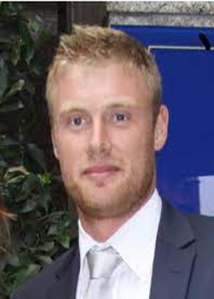
What do these celebrities have in common?
They have all suffered with an eating disorder.

Slide 2
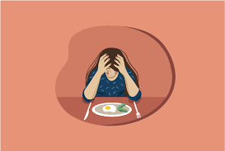
Eating Disorders
LO: To learn about how eating disorders can start and where and how to get treatment for them.

Slide 3
Key Words: Match up activity.
Key Words | Meaning
Anxiety | Doing things to compensate for eating, e.g. Vomiting or taking laxatives/diuretics.
Self-harm | A feeling of worry, nervousness, or unease about something with an uncertain outcome.
Purging
 | Self-harm is deliberately causing harm to yourself, often as a way of dealing with upset or overwhelming situations.

Slide 4
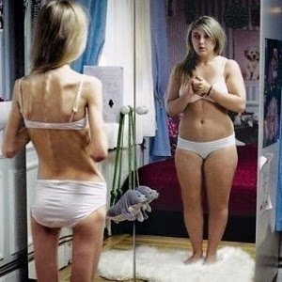
What is an eating disorder?
Eating disorders are serious mental illnesses affecting people of all ages, genders, ethnicities and backgrounds.
People with eating disorders use disordered eating behaviour as a way to cope with difficult situations or feelings.
This behaviour can include limiting the amount eaten, eating very large quantities, getting rid of food eaten through unhealthy means (e.g. making themselves sick, misusing laxatives or excessive exercise).
Eating disorders are not all about food itself, but about feelings.
The way the person treats food may make them feel more able to cope, or may make them feel in control.
An eating disorder is never the fault of the person experiencing it, and anyone who has an eating disorder deserves fast, compassionate support to help them get better.

Slide 5
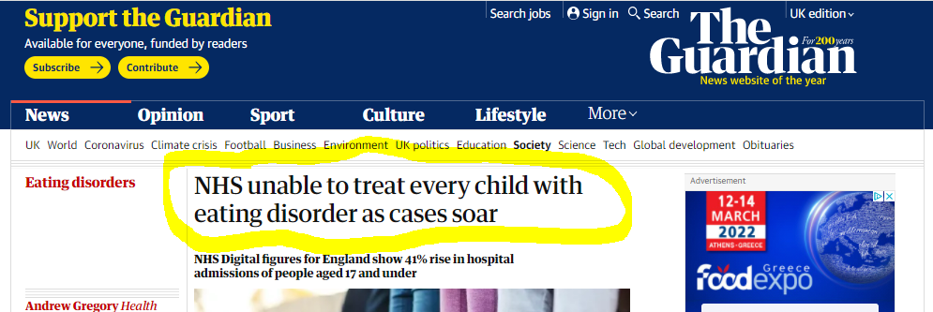
Figures reveal hospital admissions for children with eating disorders have risen 41% in a year
Charities said the fast rising number of hospital admissions was “only the tip of the iceberg”, with thousands more children needing support for eating disorders
Discuss as a class: Why do you think this has happened during the pandemic?

Slide 6
Reasons could include:
Increased isolation from friends and family
A lack of control over your own life and decisions
Chance to spend more time on social media
Some social media and news sites focussing on not gaining weight during the pandemic
Lack of access (or much slower access) to local services for help
Heightened anxiety about the ‘unknown’ situation

Slide 7
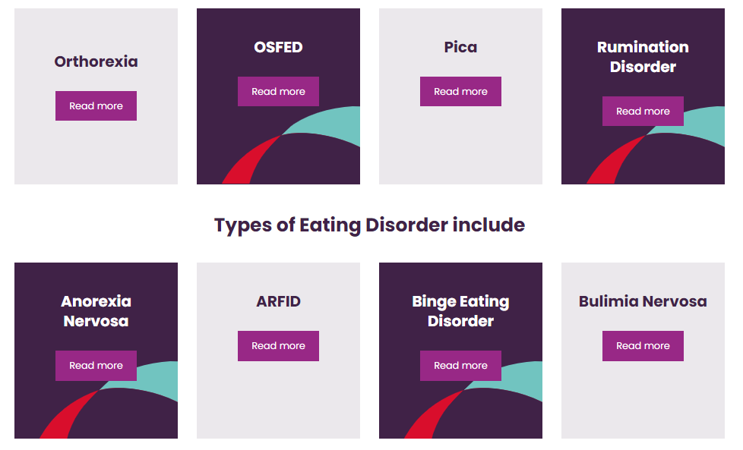
You will now work in small groups.
Task:
Using the information sheets, research some of the types of eating disorders. Be prepared to feedback to your classmates. What is it? Symptoms Etc

Slide 8
Feedback time!
As your classmates feedback their findings, write the name of the eating disorder in your PSHE book and write down 2 facts about it.
ARFID
Anorexia
Bulimia
OSFED
Orthorexia

Slide 9
Watch Jodie’s Story
https://www.youtube.com/watch?v=MprkgCuCu80
Think about:
What influences affected Jodie’s anxiety and feelings about her body?
What symptoms of anorexia did she suffer with?
What methods helped her make her recovery?

Slide 11
Eating Disorders and Men
https://www.youtube.com/watch?v=d7qYccObggc
Watch Freddie’s story and think about:
What influences affected Freddie?
What symptoms of bulimia did he suffer with?
How and why did he keep it a secret for so long?
What methods helped her make her recovery?

Slide 12
Starting to recover…
https://youtu.be/DUSTcEmCJ_0
https://www.merseycare.nhs.uk/our-services/halton/children-and-young-peoples-community-eating-disorder-service

Slide 13
RECOVERY
You can recover from an eating disorder
Getting help for an eating disorder
If you think you may have an eating disorder, Talk to someone as soon as you can
A GP is a good place to start, they may ask about your eating habits and how you're feeling, plus check your overall health and weight
They may refer you to an eating disorder specialist
It can be very hard to admit you have a problem and ask for help. It may make things easier if you bring a friend or loved one with you to your appointment.
You can also talk in confidence to an adviser from eating disorders charity Beat by calling their adult helpline on 0808 801 0677 or youth helpline on 0808 801 0711.

