Slide 1
This lesson is about Domestic Abuse, which is violence and other forms of abuse in the home.
This is a topic that some people may find difficult for any number of reasons.
If you feel you need to leave the room, please speak to your class teacher.
Notes:
In cases of pupils feeling they cannot stay=please e mail Emma Cleator-Webb

Slide 2
Retrieval: What do the letters stand for in PSHE?
PSHE
Personal Social Health Economic

Slide 3
Domestic Violence: The Facts
1 in 4 women experience it
1 in 6 men experience it
1 million women experience it per week (UK)
750 000 children witness it per week (UK)
2 woman die from this per week (UK)
Before seeking help, women will, on average experience it 35 times
Do any of these facts surprise you?

Slide 4
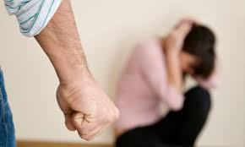
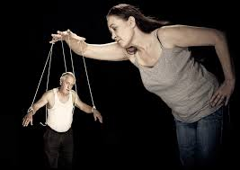
Domestic Abuse
LO: To learn what domestic abuse constitutes and how it can affect people.
Abuse-to treat with cruelty or violence, especially regularly or repeatedly.
Tier 2 Vocabulary
Notes:
LOOK AS TWO TIER VOCAB TOGETHER.

Slide 5
Healthy Relationships…
Discuss:
What do you think is meant by the term ‘healthy relationship’?
Task:
What might a healthy relationship look like? Create a mind map in your book and add your ideas. Discuss them as a group and add anymore that you feel are relevant.
Some ideas…
Respectful
Kind
Each person allowed to make their own decisions
Empowering
Fun
What else would you add?

Slide 6
76% of domestic violence incidents are repeat offences
In 54% of serious sexual assaults, victims were assaulted by their partner or ex partner
What are your thoughts on this?
One incident of domestic violence is reported to the police every minute.
(Think about it: During your tutor time in school, there will have been 20 reported attacks. How many unreported attacks do you think there may have been in this time?)
Notes:
http://www.cps.gov.uk/news/articles/domestic_violence_-_the_facts_the_issues_the_future/
Think pair share then write a sentence or two

Slide 7
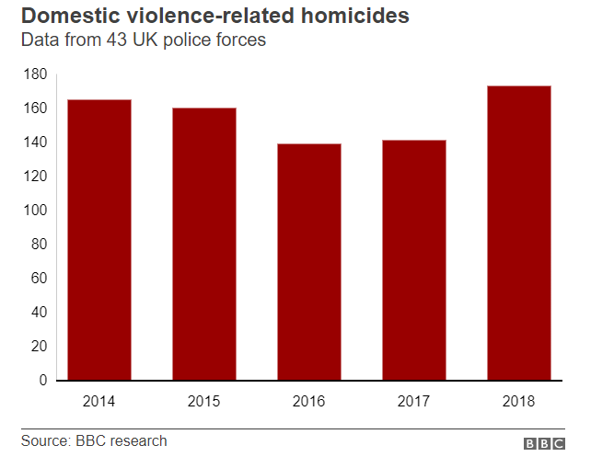
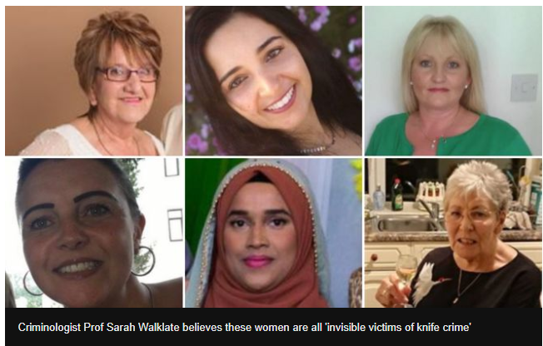
Recent information…
Notes:
Discuss each piece of info.

Slide 8
Types of Abuse
Emotional Abuse | Can you match the definitions to the kinds of abuse?
Physical Abuse
Sexual Abuse
Identity Abuse
Financial Abuse
Notes:
Card Match Exercise (10)

Slide 9
 | Hitting, beating, choking, pushing, slapping, kicking, pulling hair, biting, punching, backhanding, arm twisting, shoving, kicking or burning or physical restraint or threatening.
 | Using personal characteristics to demean, manipulate and control the partner. Overlaps with emotional abuse: i.e. suggesting that the partner will never have another relationship because he is too ugly or too old
 | The use or misuse, without the partner’s freely given consent, of the financial or other monetary resources of the partner or of the partnership. i.e. forbidding the partner to work.
 | any use of words, voice, action or lack of action meant to control, hurt or demean another person. Typically includes ridicule, intimidation or coercion. Verbal abuse usually is included in this category.
 | Any forced or coerced sexual act or behaviour used to acquire power and control over the partner. It is not only forced sexual contact but also contact that demeans or humiliates the partner and instigates feelings of shame or vulnerability.
Notes:
Card Match Exercise (10)

Slide 10
Emotional Abuse | any use of words, voice, action or lack of action meant to control, hurt or demean another person. Typically includes ridicule, intimidation or coercion. Verbal abuse usually is included in this category.
Physical Abuse | Hitting, beating, choking, pushing, slapping, kicking, pulling hair, biting, punching, backhanding, arm twisting, shoving, kicking or burning or physical restraint or threatening.
Sexual Abuse | Any forced or coerced sexual act or behaviour used to acquire power and control over the partner. It is not only forced sexual contact but also contact that demeans or humiliates the partner and instigates feelings of shame or vulnerability.
Identity Abuse | Using personal characteristics to demean, manipulate and control the partner. Overlaps with emotional abuse: i.e. suggesting that the partner will never have another relationship because he is too ugly or too old
Financial Abuse | Financial abuse is the use or misuse, without the partner’s freely given consent, of the financial or other monetary resources of the partner or of the partnership. i.e. forbidding the partner to work.
Notes:
Card Match Exercise (10)

Slide 11
In 2015, coercive control became illegal. It is often used in cases of domestic violence.
What is coercive control?
Coercive control is when a person repeatedly behaves in a way which makes you feel controlled, dependent, isolated or scared.
The following are common examples of coercive control:
isolating you from friends and family
controlling how much money you have and how you spend it
monitoring your activities and movements
repeatedly putting you down, calling you names or telling you that you are worthless
threatening to harm or kill you or your child
threatening to publish information about you or report you to the police/authorities
damaging your property or household goods
forcing you to take part in criminal activity

Slide 12
What kind of abuse?
A
B
C
D
E
F
G
H
Look at the posters around the room and see if you can identify which kind of domestic abuse they are referring to.
Extension:
Which did you find most powerful and why?

Slide 13
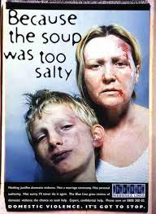
a
b

Slide 14
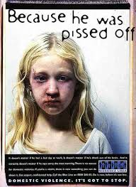
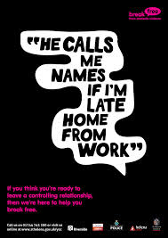
d
c

Slide 15
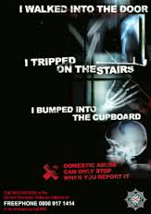
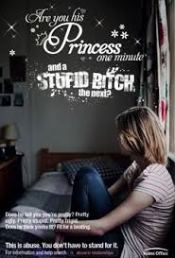
e
f

Slide 16
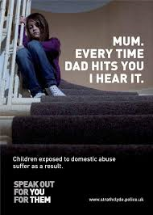
g
h
Notes:
10 mins

Slide 17
Official Statistics
Official statistics rarely show the true extent of domestic violence.
What reasons might there be for this??

Slide 18
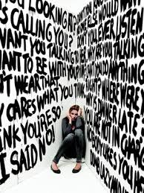
How many can you see?
The different kinds of abuse can often happen at the same time.

Slide 19
https://www.youtube.com/watch?v=5Z_zWIVRIWk
Answer the following questions in your PSHE book:
Domestic violence is…
What might happen to the woman if she asks for help?
Can you think of any schemes the police could introduce so victims can always get help (even when they cannot openly ask for it)?
Notes:
https://www.youtube.com/watch?v=5Z_zWIVRIWk

Slide 20
Watch the clip What kinds of abuse do you see?
I see…
Notes:
https://www.youtube.com/watch?v=_AK3jPNbWu0 – Antonio Banderas
https://www.youtube.com/watch?v=_lDncgUwor4 – United Colours of Benneton
https://www.youtube.com/watch?v=5Z_zWIVRIWk -

Slide 21
What excuses do abusers use? What reasons do people who are abused use to stay in relationships?
Abusers say…
People who are abused say…

Slide 22
What about men?
Why do you think fewer men report domestic violence?
What could be done to encourage more men to report it?
Notes:
0:28-1:45

Slide 23
Children’s thoughts…
https://www.youtube.com/watch?v=LbRba9XHKKw
What affect do you think domestic violence has on children?
How might it make them feel?
Notes:
https://www.youtube.com/watch?v=b2OcKQ_mbiQ

Slide 24
Where can I get help? If you are a victim of domestic violence or witness it, you can get help…
Speak to any member of staff
In an emergency call the police
Childline 0800 1111
NSPCC 08088005000
National Domestic Violence Helpline 08082000247
The Hideout www.thehideout.org.uk
Respect Not Fear www.respectnotfear.co.uk

Slide 25
1 thing that surprised me in todays lesson:
1 thing this lesson made me feel:
1 thing I learnt from this lesson:

