Slide 1
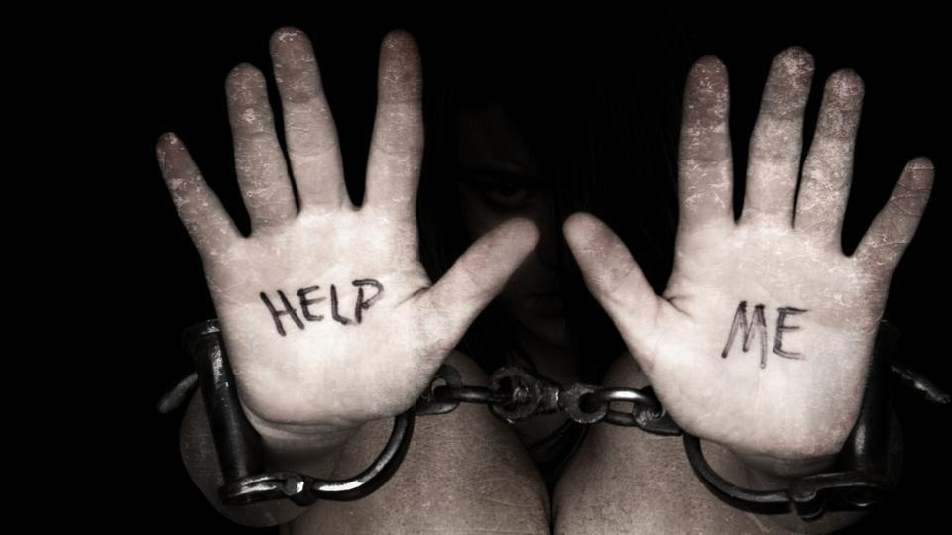
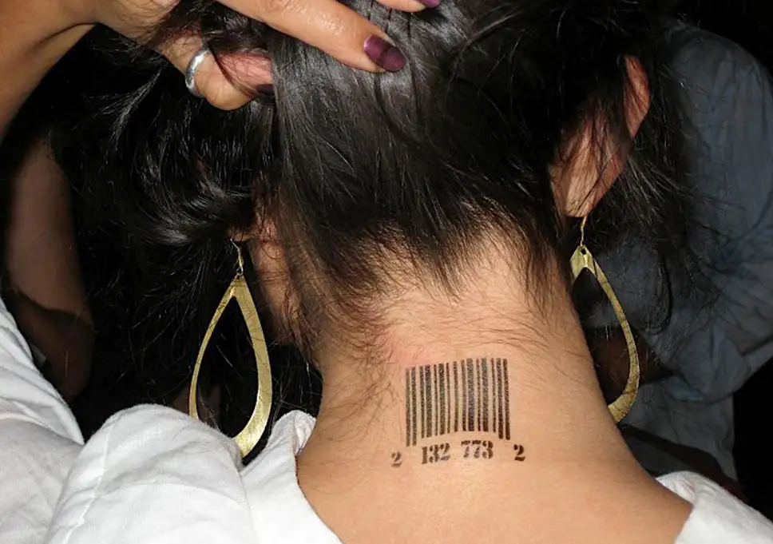
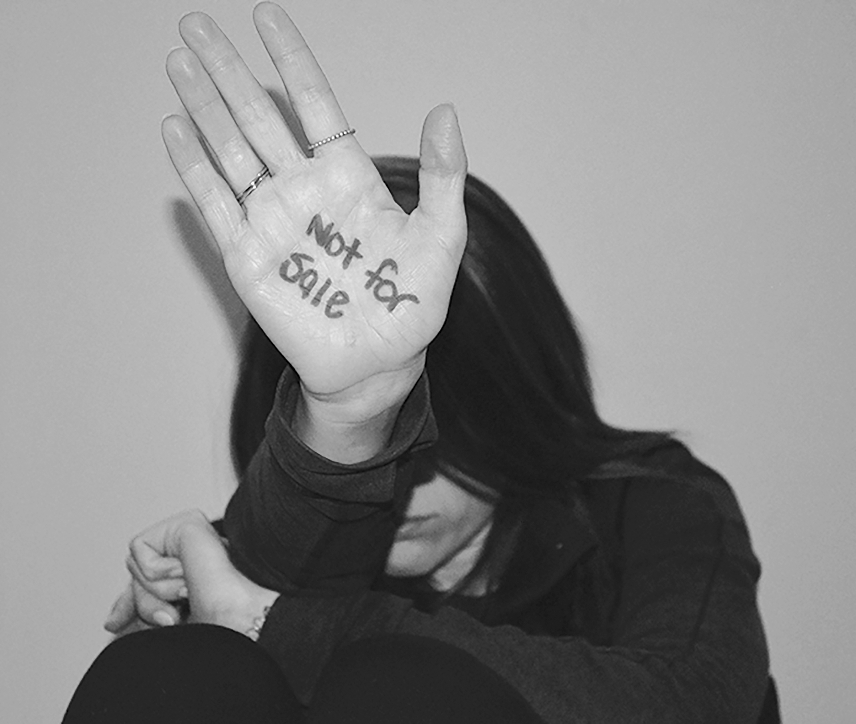
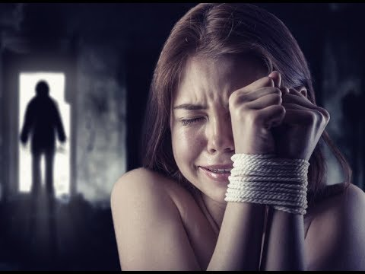
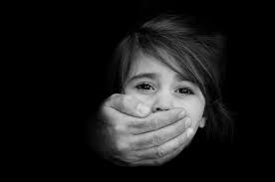
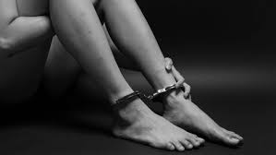
What do you think the topic is today?

Slide 2
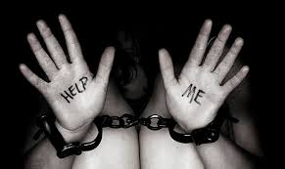
Human TRAFFICKING
LO: To learn about how this happens and to recognise the signs that can show if someone is a victim.
Unbelievably, this is an actual photo from a human trafficking case, the man gave each ‘slave’ a barcode to keep track of them.
What does this remind you of?
Notes:
Pupils may link it to the Jewish victims of the Holocaust, who were tattooed with a number.

Slide 3
What is Human trafficking?
It is defined by the United Nations Office on Drugs and Crime as:
The Act of recruitment, transportation, transfer, harbouring or receipt of persons, by means of the threat or use of force or other forms of coercion, of abduction, of fraud, of deception, of the abuse of power or of a position of vulnerability or of the giving or receiving of payments or benefits to achieve the consent of a person having control over another person, for the purpose of exploitation.
Often referred to as modern day slavery, human trafficking is made up of three elements:
Movement or recruitment by
Deception or coercion for
The purpose of exploitation
Notes:
Involve all pupils in reading the slides. Discuss meaning of deception/coercion/exploitation.

Slide 4
Types of exploitation. 2-3 mins…People can be exploited (used so that others are benefiting from them) in many ways. Can you think of any examples, using the pictures below.
Notes:
ALLOW 2-3 MINS
Ways could include: Used to transport or sell drugs, for financial gain, to work on farms unpaid, to transport weapons, forcefully moved from one place to another, threatened etc

Slide 5
Modern slavery encompasses:
Slavery
Human trafficking
Servitude (being under the control of someone else and of having no freedom)
Forced labour
Traffickers and slave masters use whatever means they have at their disposal to coerce, deceive and force individuals into a life of abuse and inhumane treatment.
https://www.antislavery.org/slavery-today/slavery-uk/

Slide 6
THINK-PAIR-SHARE
What type of situations could people be trafficked into?
What might their abusers want them to do, in order to profit?
Notes:
Discussion

Slide 7
DOMESTIC SERVITUDE
Domestic workers are based in their employer’s home. The arrangement becomes exploitative when the workers movements are restricted or they are forced to work long hours for little/no pay. They may suffer physical/sexual abuse.
SEXUAL EXPLOITATION
When someone is forced to take part in sexual activity. Examples include prostitution, phone sex lines, pornography or mail order brides.
FORCED CRIMINALITY
People forced into criminal activity. It can take many forms, including drugs trade, bag snatching, ATM theft and selling counterfeit goods. It can also be social welfare fraud; when exploiters apply for welfare benefits using the victims’ details.
ORGAN HARVESTING
This involves removing a part of the body to sell, illegally. Organs can be taken in many ways:
Trade – a victim formally/ informally agrees to sell an organ, but are not paid or paid less than promised.
Ailments – a vulnerable person is treated for an ailment and the organs are removed without their knowledge.
Extortion – a victim is kidnapped and their organs removed without consent.
LABOUR EXPLOITATION
People are coerced to work for little or no pay, often under threat of punishment. Use of violence or intimidation, accumulated debt, retention of identity papers and threat of exposure to immigration authorities are just some ways people can be coerced.
Common areas are manufacturing, factory work, agriculture, car washes and nail bars.
FORCED MARRIAGE
A person is put under pressure to marry. They may be threatened with physical/sexual violence or placed under emotional/psychological distress. The abuser may wish to gain access into a country or claim the person’s benefits
Notes:
Ask different pupils to read each type of exploitation. Discuss where appropriate.

Slide 8
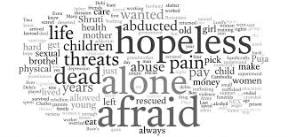
A victim of human trafficking.
https://www.youtube.com/watch?v=jHcoEY6gJJ0
Watch the above clip.
What did you think of Rebecca’s story?
How did her abuser control her?
Were you surprised by her story?
Why was Rebecca scared to go home?

Slide 9
What is the scale of the issue?
How many people does this class estimate are involved in slavery, in the world today?
An estimated 40.3 million victims are trapped in modern-day slavery.
Of these:
24.9 million were exploited for labour.
15.4 million were in forced marriage.
There are 5.4 victims of modern slavery for every 1,000 people in the world.

Slide 10
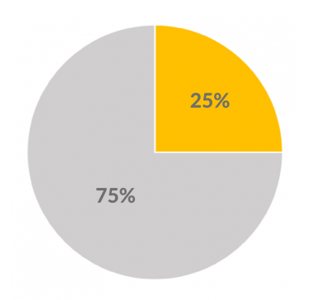
Human trafficking and modern slavery do not discriminate; they affect men and women of all ages.
Do these figures surprise you?
Which figure has the most impact? Why?
71% of trafficking victims around the world are women and girls and 29% are men and boys.
30.2 million victims (75%) are aged 18 or older, with the number of children under the age of 18 estimated at 10.1 million (25%).
37% victims of trafficking in forced marriage were children.
21% victims of sexual exploitation were children.

Slide 11
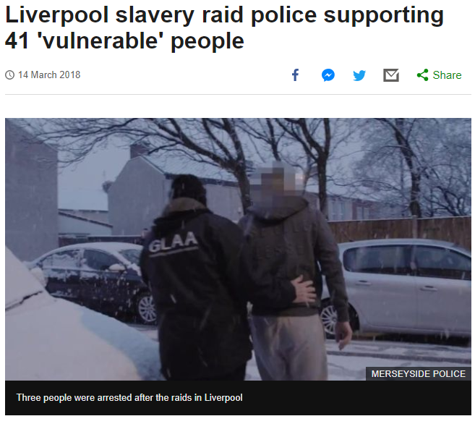
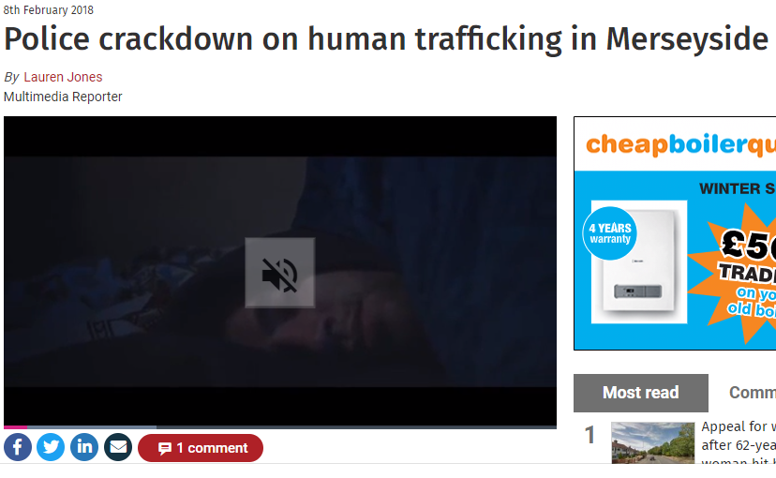
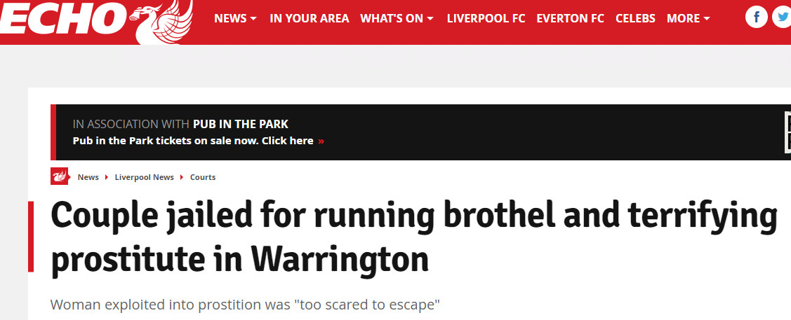
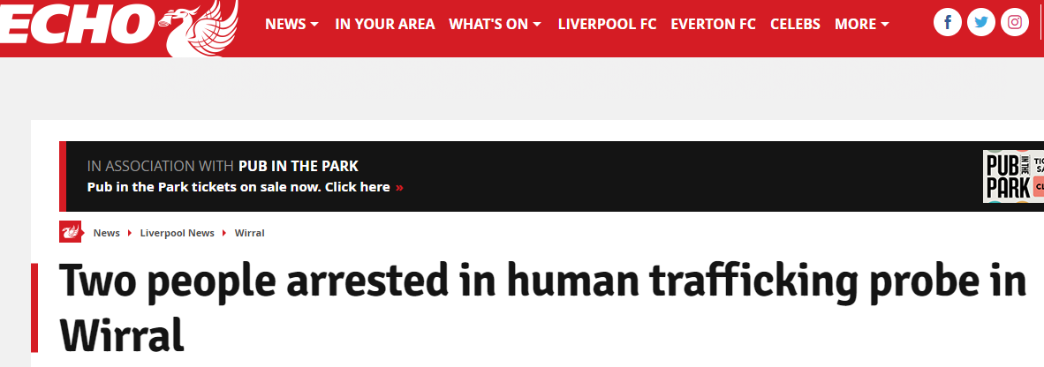
It doesn’t happen near me…….

Slide 12
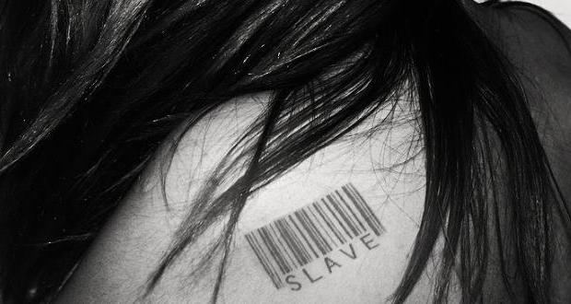
what can you do to help?
Read the information on the next slide.
In small groups, use it to come up with an eye-catching slogan or memorable acrostic to help people remember the key things to look out for in cases of human trafficking.

Slide 13
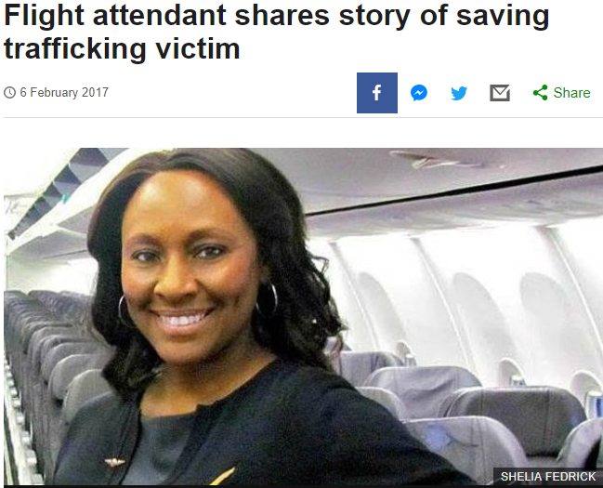
When people know what to ‘spot’
https://www.youtube.com/watch?v=wFcK3cn4IpQ
https://www.youtube.com/watch?time_continue=2&v=tuI2_iR7nQ8

Slide 14
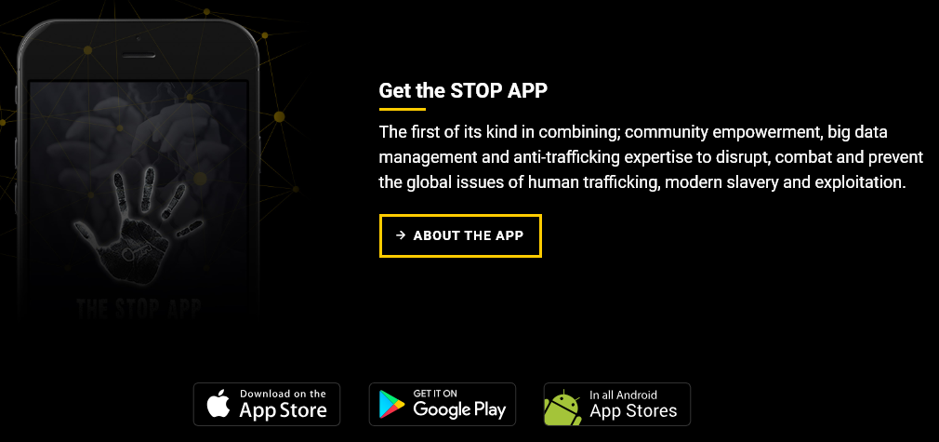
See the unseen-spot it, stop it.
https://www.youtube.com/watch?time_continue=77&v=1RBblPD60Wg
For more information on this issue, visit
www.stopthetraffik.org

